Slide 1

Daily Management Routines
David Greer OPEX Coach
Notes:
Title Slide: Introduce the Module
Hello and welcome to the Daily Management Routines webinar hosted by Invest NI. My name is David Greer and I am an Operational Excellence Coach, working for the Operational Excellence Solutions Team.
The intent of this webinar is, to give you a high level understanding of some of the structures that can help your business increase visibility of performance, instil key behaviours and ultimately grow and improve.

Slide 2
Contents
What are daily management routines
Why do we need them now
Link to business planning
Tier 1, 2 & 3 meetings
Cross-functional planning
Leader standard work
Leader visibility
The system for daily management routines
Notes:
Slide 2: Contents Slide
In this webinar we are going to talk about the daily management routines that can help your business achieve its goals,
by reinforcing on a daily basis the correct focus and behaviours required throughout the business at all levels.
We are going to cover the following,
What are daily management routines, and how they can help your business improve
Why do we need them now , in the current climate
The Link to business planning, in the new paradigm
The Daily morning meeting structure, what it is, and how does it work
Cross-functional planning, how to improve how we manage key interdependencies
Leader standard work, who, what, where and when key actions need to take place
Leader visibility – a structured engagement of teams and individuals
The system for daily management routines where we combine the parts to make the whole

Slide 3
What are Daily Management Routines?
A continuous process of daily actions undertaken by leaders to reinforce the culture and behaviours required to;
– Engage employees
– Solve problems
– Achieve business goals
A structure that supports the team to have a GOOD DAY
Notes:
Slide 3: What are daily management routines
What are daily management routine?
They are a continuous process of daily actions undertaken by leaders to reinforce the culture and behaviours required to;
Engage employees
Solve problems
Achieve business goals
So if we think about the teams in our businesses, and ask ourselves.
Do they know if they are having a good day?
And if we also ask, do they know the actions that need to be completed to increase the likelihood of having a good day.
Let’s say, one of the ways we know it’s a good day is when we have hit our planned production.
How can we ensure we hit our plan?
1st we need to know what the plan is.
And We would assume the team need to see that plan and that they would need see that plan before they start work that day.
So a daily routine could be to post the plan for the next day prior to the end of shift of the previous day.
This means that the actions support the team having a good day by ensuring the plan is clearly communicated.
So we have the behaviours and action to ensure the plan is known.
Now how do we know are on target to hit our plan?
We have further actions to review our adherence to plan regularly throughout the day backed up by management review.
In order to ensure we have this focus continually and make it habitual we need these actions performed on a daily basis by the same people, at the same time, every day. Now we must ensure this habit is sustained by a combination of visual management, process confirmation and leader checks.

Slide 4
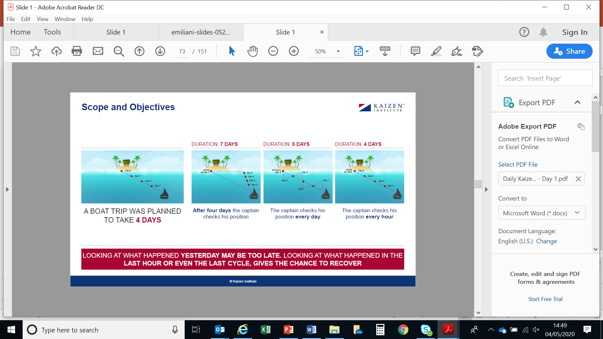
Are we on Course?
DURATION: 7 DAYS
DURATION: 5 DAYS
DURATION: 4 DAYS
A boat trip was planned
to take 4 DAYS
After four days
the captain checks
his position
The captain checks
his position every day
The captain checks
his position every hour
Looking at what happened YESTERDAY MAY BE TOO LATE. Looking at what happened in the LAST HOUR or even the LAST CYCLE, GIVES THE CHANCE TO RECOVER.
Source: Kaizen Institute
Notes:
Slide 4: Are we on Course?
To demonstrate what is meant by this, I would like you to picture yourself as the captain of a Boat,
ANIMATION 1 : ahead of you, you have a journey to an island. You have to reach this island in 4 days to drop off your passengers. So you set off toward the island, but after 4 days the boat doesn’t arrive at the island.
ANIMATION 2 : You now check where you are and find you have sailed off course and now have 3 days travel to get to the island, totalling journey time of 7 days.
ANIMATION 3 : Now picture if you head off on the same journey, however this time
You check the course and heading and correct on a daily basis. The course corrections would not be as drastic as in scenario 1
and the journey would be less , however the journey will still take longer than the desired 4 days.
ANIMATION 4 : Now picture that you head off on the same journey, however this time
you check the course and heading on an hourly basis. The more frequent and minor corrections would keep the ship on course and we would arrive on time at 4 days.
So if we think about the boat as your business and the island as your targets, then we can see that it makes sense to regularly review performance and correct our course.
In order to facilitate this we use daily management routines to build in structure and behaviours that support this. These are the ideas that we will be discussing as we move forward.

Slide 5
Why is this important now?
Heightened or more severe pressure on the business posed by the COVID-19 crisis
Reduction in sales/orders
Supply chain difficulties/sourcing supplies
Availability of employees & skills
Health & Safety or Social Distancing requirements
Government restrictions i.e. Non-essential business
Other (explain below)
Cash-flow difficulties conserving cash
Reduction in production/operations capacity
Absenteeism
Ability to work remotely
Restrictions on travel
The need for co-ordination of people and resources
has potentially never been higher
Notes:
Slide 5: Why Now?
So why are we talking about this now?
Well with the Covid-19 crisis and the ongoing economic uncertainty,
we are going into a time with potentially severe pressure placed on business.
We could be looking at
ANIMATION 1 : lower sales,
ANIMATION 2 : restricted cash flow,
ANIMATION 3 : supply chain difficulties
ANIMATION 4 : reduced capacity or
ANIMATION 5 & 6 : to name just a few.
Due to these unprecedented times your business could be facing one, some or even all of these issues.
This pressure could mean a change in your operating model to adjust to the new “normal”
and the structures we are talking about today can help position your internal resources to help you to adjust.
ANIMATION 7 : So the need for coordination of people and resources has potentially never been greater and the need to be agile and responsive could make all the difference.

Slide 6
Co-ordination of the whole
Highlight important
interdependencies
Grasp current condition
Set goals and timelines
Ensure communication is
focused on the important stuff
Doing the RIGHT THINGS RIGHT
Customer
Order
Order
Fulfilment
Delivery
Invoicing
Customer
Payments/
Collection
Notes:
Slide 6: co-ordination of the whole.
To be agile and responsive we need to think about how we coordinate our whole organisation.
To help this we must highlight the key interdependencies.
What we sell informs what we make
When we deliver informs when we will get paid
When & what we get paid informs when and what we can buy
What inventory we hold informs what we can build
What we can build informs what we can sell
And it goes on.
What we need now potentially more than ever, are these processes, outputs and interdependencies being discussed in a structure way regularly.
When we talk to some business owners and managers a response we often get is “we don’t need to do this every day”.
If you are thinking this now I would like you to consider the following
Say you have a business with 50 people, across 6 departments with 20 interdependencies all linked in a flow that delivers to the customer.
Now let’s consider how many decisions a day you make,
is it 1?
is it 2?
is it 10?
or is it 50?
Lets go for a conservative 10 decisions a day.
Now we have 50 people who are all individually making, 10 decisions a day, all with the best of intentions.
What are the chances that those 500 decisions are collectively driving your business to deliver better for your customer and for the business?
This is not even with the added layer of complexity we are having to deal with in the aftermath of the Covid-19 crisis.
Now imagine those people are making those decision having been given the most up to date direction that day.
How much better would their decision making be? And in turn how much better would the performance of your business be.
We would have a much better chance of doing the RIGHT THING RIGHT.

Slide 7
Start with a Plan
Start with the next 6 weeks
What is the target for the next 6 weeks
KPIs and boards reflect the
6 week goal
Break these down into weekly
progressive actions
Big 3 – Focuses for the week
cascaded to every level
Review at each Tier
Notes:
Slide 7: start with the plan
So where do we start?
Well the answer to this is quite straight forward in theory and a little harder in the current context. Simply put, we start with the plan for the business. What is the business trying to achieve and what does success look like.
Of course context is everything and this plan is no different. Pre Covid-19 a business may have developed a plan or strategy looking out 1 to 3 years.
The world we live in now is not the same for many businesses and this timeframe may be unrealistic.
The truth in the post Covid-19 landscape, is that businesses may need to be planning as close as 6 weeks out and adjusting, as their path becomes clearer.
This complexity in the environment and the shortening of the planning cycle is another clear reason that daily management routines are applicable as much, if not more than previously.
The plan should inform the measures that are critical to the business. For example, let’s say you are trying to achieve the following in the next 6 weeks.
£400,000 of sales
An Inventory level of less than £50,000
And a reduced lead-time of 3 days
ANIMATION 1 & 2 these short term targets provide a measure for success that can then be translated into a big 3 for each department or area within the business.
In a number of companies, they call these ‘Big 3’ their WINs (What’s Important Now) (Kellogg’s use this terminology, as do a lot of automotive companies)
We then use the daily management routines set out in the rest of this webinar to reinforce the focus on these key areas of importance.

Slide 8
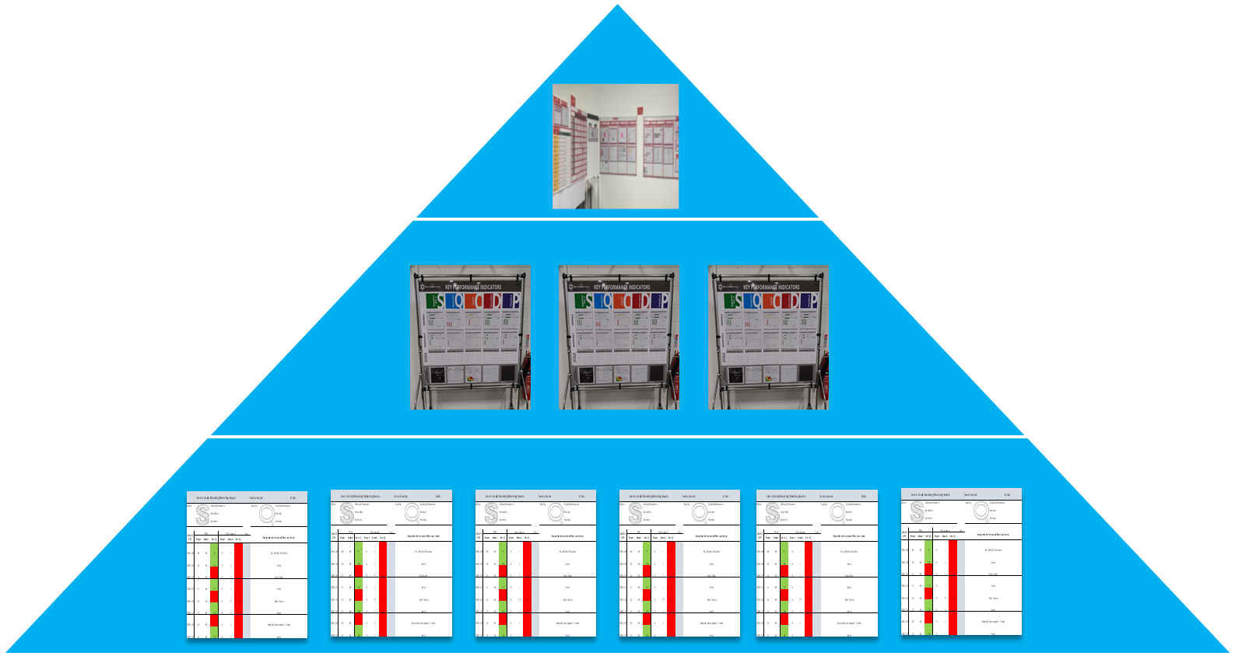
Cascading of the Plan
6 WEEKS CHALLENGE
Current Condition
Target Condition
…to get
closer to our
Challenge.
Where are
we now?
Where do we
have to be in
1 week…
TIER 3
TIER 2
Performance & Escalation
Objectives, Measurements & Targets
TIER 1
Notes:
Slide 8: Cascading of the Plan
These key areas of focus, measures and targets from the 6 week plan need to be communicated and cascaded through the business.
ANIMATION 1
If you look at the pyramid on the slide, you will see that the leaders within the business set the direction or the plan. Then they decide on the measure that indicate the performance needed. The plan, measures and performance expectations are then fed down the organisation through the structure of daily meetings and Big 3 focus areas. This ensures that the priorities for the overall business are known and teams are focused on their delivery.
At each cascade level and across different teams the measures may change. This will depend on the span of control of the team and the applicability of the measures. For example an operational team does not have a direct impact on the sales value but they do have a direct impact on on-time delivery and cost of production. Which will in turn effect the sales if they are not acceptable to the customer.
ANIMATION 2
This is not a one way system, as you can see from the diagram the measure and expectations going down is not the whole story. What you can see flowing up is performance to the plan and escalations of issues stopping the business progressing. This is key to the success of the plan. This feedback and escalation is then used to reflect on the plan and to hone and adjust moving forward. This gives a more robust plan based on data around actual performance.
At this point it is probably important to note that, the number of levels will be company specific.
The larger the organisation and the number of levels will dictate the number of Tiers that are required to successfully implement and support the new way of working.
Typically it is one tier for each level of management or supervision, however you will need to adjust to suit your own structure. Or indeed maybe you will need to review your structure to support this new approach.
If you are from a small company and are thinking that the concepts in this webinar seem like a lot to manage. Please remember that what we are showing you here is the system as designed, however it can be adapted to your organisation. You will still need a plan, with objectives, measures and targets. You will still need to communicate the plan and measure performance and you will still need to highlight and address issues.
So I would encourage you to consider throughout the rest of this webinar, no matter the size of your business, what these tools and principles would look like when applied in your context.

Slide 9
Tier 1 Board with
Short Interval Control
Line 1 Daily Monitoring Meeting Board Team Leader: Date:
Safety: Safety Information Near-Miss Accident |  |  |  |  |  | Quality: Quality Information Internal External
Order/ QTY | PPM |  |  | Give Away % |  |  | Cost | Reason for Variance and Time Lost (mins)
 | Target | Actual | Var. +/_ | Target | Actual | Var. +/_
ID101/40 | 40 | 40 | 0 | 0 | 1 | 1 |  | GA – Within Tolerance
ID102/20 | 20 | 40 | 20 | 0 | 2 | 2 |  | Stock
ID101/41 | 41 | 40 | 1 | 0 | 3 | 3 |  | Slow Start
ID102/21 | 21 | 40 | 19 | 0 | 1 | 1 |  | Stock
ID101/42 | 42 | 40 | 2 | 0 | 1.5 | 1.5 |  | Don’ Know
ID102/22 | 22 | 40 | 18 | 0 | 3 | 3 |  | Stock
ID101/43 | 43 | 40 | 3 | 0 | 2 | 2 |  | Material not prepared – 3 mins
ID102/23 | 23 | 40 | 18 | 0 | 1 | 1 |  | Stock
Tier 1: Start of shift, led by
production team leader
Review previous 24 hours
Set out plan for next 24 hours
Short Interval Control:
Periodic (hourly) update on
plan adherence and reasons
for not hitting target
Notes:
Slide 9 – Tier 1 & Short Interval Control
To explain the structure used in more detail, it is perhaps easier to start at the bottom of the pyramid.
We will start with the front line Tier 1 with Short Interval Control.
The Tier 1 meeting is a short start of shift meeting with the team in an area.
In this meeting the team leader will guide the team through their performance for the last 24hrs across the key measures linked to the top level plan.
The team leader will then go through the plan for today and the team will then highlight and discuss any impediments known and agree to action or escalate.
The focus of this meeting is to ensure the team know what is expected and that they have the best possible chance to achieve success that day.
From this meeting the team leader will update the next level on performance and escalate any issues that the team cannot solve themselves that day.
The Short Interval Control section you can see on the right hand side of the slide is a way of getting as close to real time information on the performance of the team and its adherence to the plan.
The team leader and the team will use this information throughout the day to make rapid decisions to ensure the target is achieved.
The closer the information can be to live the better it will be for decision making and recovery.
Where automated updates are not possible, best practice would be an hour by hour status update.
If this is not possible then the team must do what is practicable. However, the minimum would be 2 updates during a shift.

Slide 10
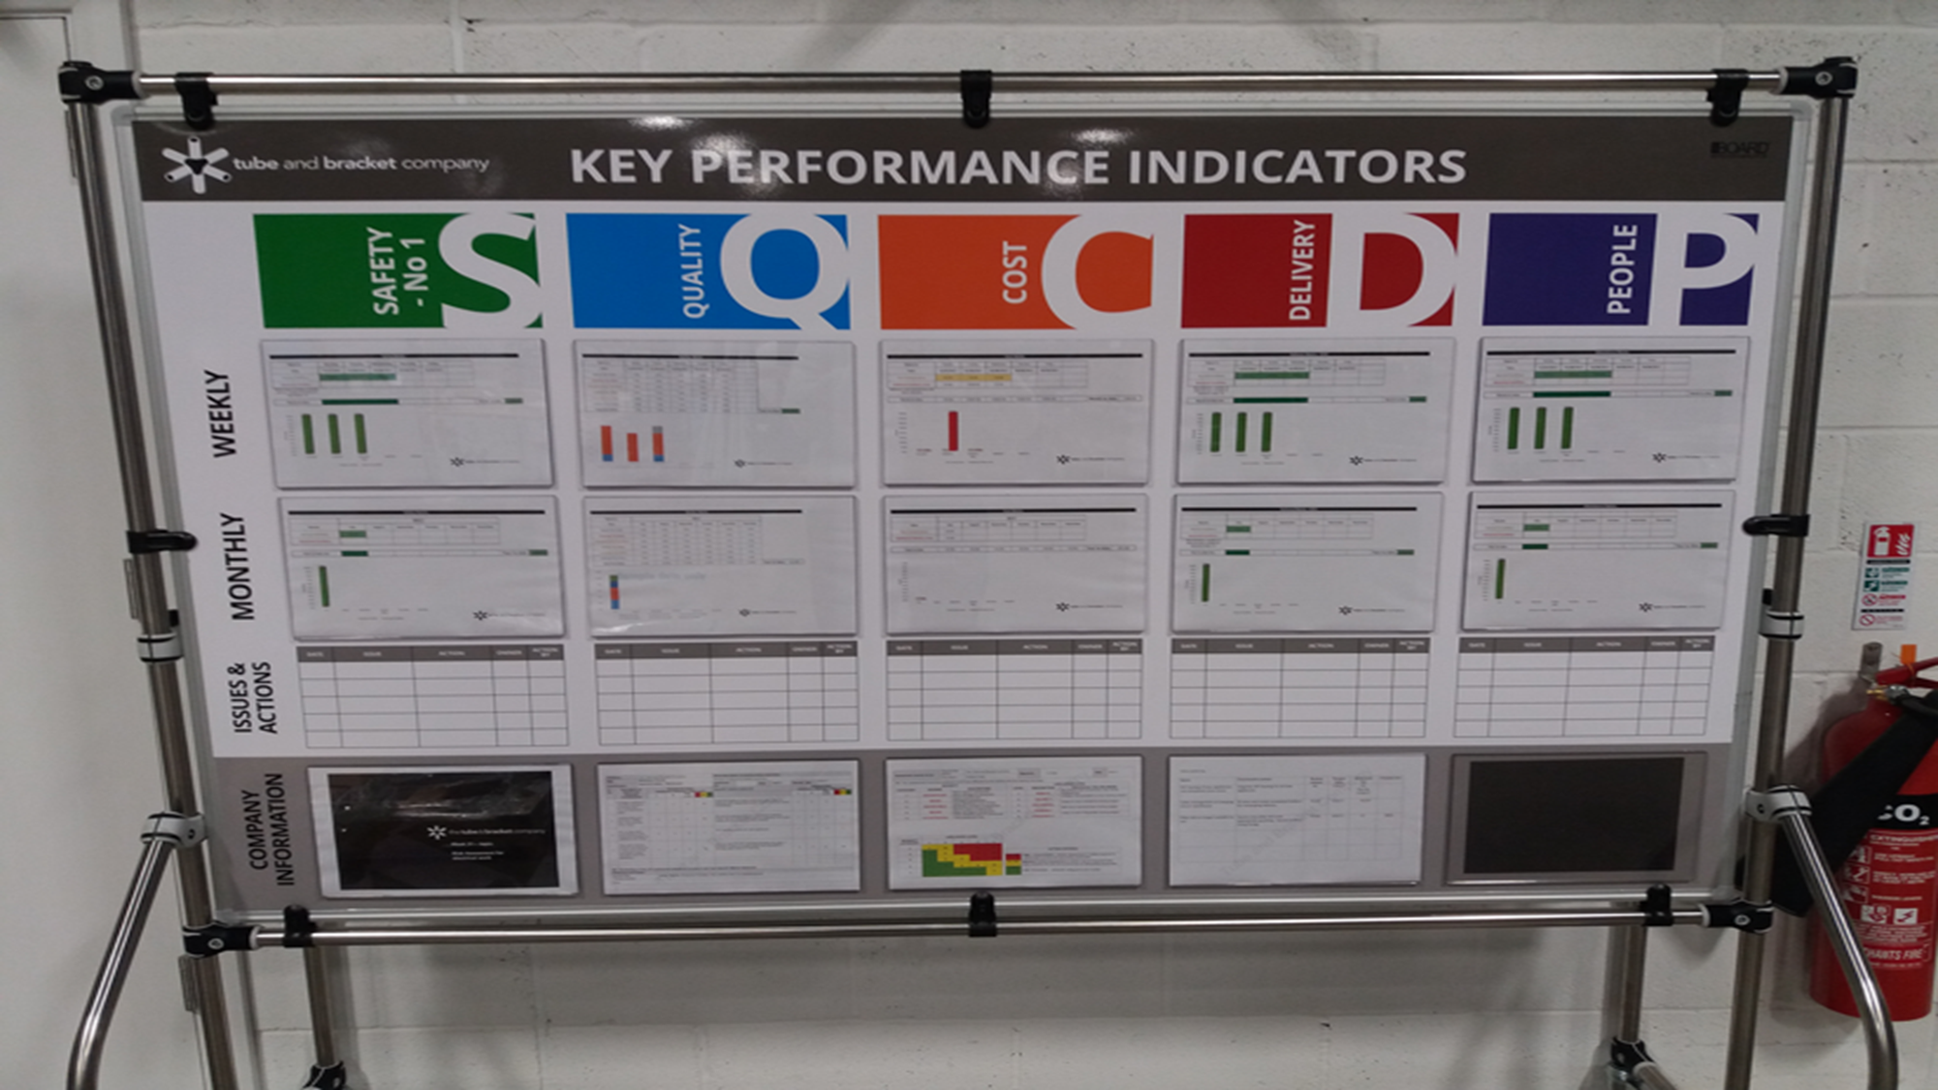
Tier 2 Board
Tier 2: Led by supervisor with production
team leaders and any dedicated support
group representatives
Aggregate of Tier 1 boards for the area
Capture of trends in performance
1st escalation point of issues that
cannot be resolved by team
Focus: Problem Solving
Notes:
Slide 10 – Tier 2
Tier 2 boards are the next level up, they are for an area consisting of multiple teams and team leaders.
The meeting is led by the area supervisor or manager, and should happen soon after the Tier 1 meeting.
It is the responsibility of the team leaders to update the aggregated measures and KPI’s from their Tier 1 boards for the meeting.
What is displayed is an overall performance for the area and trends of past performance.
At this meeting we branch out to a more cross-functional team. Here any function or department that has a daily direct contact or an impact the areas success will be represented. This person will be an active member of the team.
The immediate focus of this meeting is to review and action the issues that have been escalated from tier 1.
Here we are working on removing immediate roadblocks for individual teams and ensure cooperation between teams and cross-functional reps, with short term (24hour) actions.
We would start this part of the agenda by reviewing the progress of actions outstanding from previous meeting. Next the escalated issues from today would be reviewed and assigned to the appropriate person or persons to progress and complete.
This ensures that the area priorities for that day are known and the required actions will take place to ensure delivery that day.
Here we also decide on the issues that get escalated to Tier 3.
The next focus at Tier 2 is to widen the focus away from today’s performance and issues.
At this level we are working to progress key priorities or the big 3 for the area as set out by the 6 week plan.
These priorities are used in conjunction with the trends on the KPIs to develop actions and strategies for improvement.
It is here were we start to see the establishing small teams to tackle problems in a structured way, to increase the medium term performance of the area.

Slide 11
Tier 3 Board
Tier 3: Led by Senior Manager with
cross-functional representation
Review of collated daily performance
Escalation point for Tier 2 issues
Big 3 progress and actions
The focus is on the business goals
and projects that will deliver them
Notes:
Slide 11 - Tier 3
Now we come to the top of the organisation where the senior managers meet to review the high level business performance daily.
At this board all senior managers from each department or function should attend. Here we get a review of the aggregated KPIs from tier 1 & 2, added with the KPIs from the rest of the wider business such as sales, margin and growth figures.
This is coupled with the escalation of issues that could not be solved at Tier 2, and will give the senior managers a picture of the health of the business that day and provide the immediate priority focus areas to ensure the level of customer service and performance.
However this is just a small part of the meeting as the main reason for Tier 3 is to focus on the medium to long term business objective and keeping the whole organisation aimed at achieving the plan.
Here we review the projects and improvement plans that are driving the business.
At this stage it useful, perhaps, to state at this meeting we do not go through the detail of each initiative. However, sponsors and project leads give a quick status update and highlight any milestones, actions or roadblocks that will be occur in the upcoming day or days.
This way the senior management can prioritise the work that happens in and between the different functions or can start to prepare for those that are coming down the line.
It is worth pointing out that these meetings do not negate the need for other specific management meeting, but should reduce the number of emergency and adhoc meetings.

Slide 12
Cross-functional Planning Meetings
Meet regularly (daily) to ensure customer demand is linked
to all aspects of the value stream
Outside of Tier 3 meeting, but will be informed by the Tier
process and Big 3
The meeting should include
– Sales
– Procurement
– Operations
– Etc.
The objective is to have a succinct and agreed plan to
achieve customer value and business goals
Notes:
Slide 12 – Cross functional planning
To further coordinate the resources in your business, it can be appropriate to have a separate planning meeting.
This would again be a cross-functional group with an agenda for medium term planning.
This would include representatives from sales, procurement, design and quality etc.
Here we would look ahead for a number of weeks to the coming production or orders.
This way the team can look at all the key interdependencies between different parts of the organisation and highlight any key areas of concern early enough to put actions in to place to mitigate the risk.
If I give you an example from my previous career, working for a large manufacturing organisation. In this organisation we had a tier system, where we held our Tier 1 meeting at 08:30 and Tier 2 at 09:30.
At 11am every day we had a planning meeting with a cross-functional natural team that looked at a rolling 6 week production schedule.
Each day against each of the functions and inter-dependencies we had a red, amber or green status.
Any reds were immediately reviewed and corrective actions were put into place.
If there was an amber within a 3 week time frame prior to the planned start, we would review and agree corrective actions to be put in place.
At this meeting we did not discuss the current day or week, this was purely to plan the medium term.
We found this invaluable in creating a cohesive team focused on creating value for the customer, rather than each function looking after their own stall independently.
The teamwork is bolstered with a structure and agenda that supports the medium term plan.
This also can lead to a decreased level of firefighting when all team members from all functions are focused and working to create value for the customer.

Slide 13
Leader Standard Work
Supervisor Standard Work Example
Mon | Tue | Wed | Thur | Fri | Daily Follow-up |  |  |  | Notes
 |  |  |  |  | Shift Start Meeting |  |  |  | Below information to be identified and reviewed during shift meeting All information to be reviewed with Prod. Mgr. during daily walkthrough
 |  |  |  |  | Safety issues (address issues immediately)
 |  |  |  |  | Quality / Part Shortage Alerts
 |  |  |  |  | Production / Tooling Issues
 |  |  |  |  | Cell Area Walk through
 |  |  |  |  | Review Action items (where applicable)
 |  |  |  |  | Review Cell Operations & W/Station Std. Work (audit each W/Station daily)
 |  |  |  |  | Address Downtime & Cell Issues
 |  |  |  |  | Review Ergonomic Issues / Opportunities
 |  |  |  |  | Cell SQDC Board (End of Shift) |  |  |  | Below information is to be checked daily and reviewed with the Prod. Mgr. during walkthrough Ensure 5S audits are conducted per each week along with charting & countermeasures
 |  |  |  |  | Chart measures against established targets (e.g. Output, Downtime, Productivity, DPU etc.)
 |  |  |  |  | Ensure all data is current
 |  |  |  |  | Establish appropriate countermeasures
 |  |  |  |  | Address issues to ensure trend improvement
 |  |  |  |  | Review Scrap (counter measured / root cause)
 |  |  |  |  | Conduct Weekly 5S Cell audit Ensure daily 5S standard work is completed Conduct daily ‘end of shift’ walkthrough
Follow-up Action to be reviewed at Shift End Meeting and Next Day Start-up meeting
What |  |  |  |  |  | Who | When |  | Comments
Document developed for all leaders
Describes daily tasks required to support the business
Document should be carried
at all times
Tasks to be ticked off as completed
Completion confirmed visually
as part of the Tier process
Notes:
Slide 13: Leader Standard Work
Now we need to look at how we make each of the preceding tiers and daily structures a habit?
To do this effectively we need to implement a key tool, this tool is called leader standard work.
This is a document carried by leaders of all levels within the business, as standard work for their day.
What we are trying to achieve with this is to organise their activity into standard repeatable tasks completed daily that reinforce the key activities that will support the teams and wider organisation.
The more senior your role within the organisation the less standard your day will become, and the opposite will be true the less senior you are.
So when we look at the level of standard work for a team leader, this could be 70% of their day, however an owner or CEO could be 10% or less.
If we were to look at a team leaders activity, there are a series of tasks that must be performed at the start of the shift to ensure a smooth day.
We need to ask
What are those tasks?
What sequence should they be ordered?
When do they need done? Who needs to be involved?
What is the desired outcome?
As we move into the shift, how does a team leader ensure ongoing performance within his area? What are the tasks throughout the day needed to ensure this performance?
Once we have established this, how do we ensure that these required tasks are completed when needed? This is where the leader standard work process comes in.
Using the leader standard work process, with the person in question, we establish the tasks, timings and output required to have a good day. We document these in a standard sheet, as seen on the slide. The leader in question carries this document with them and marks off the tasks as completed, at the time designated. On this sheet there is also a place to capture issues and notes for the purpose of ensuring the day goes well and or escalation. Once the tasks for the day are completed the team leader will update the leader standard work confirmation visual management at the appropriate tier board.
Each level of leader standard work should support the level below and above. For this to be possible the leader standard work needs to be designed in totality.

Slide 14

Leader Visibility – Go See
Led by Senior Management
Regular and structured ‘Go See’ activity
Increases senior leaders visibility
and team members access
Focuses on problem solving
Used to build leaders as coaches
This is not a walk or tour. It is a cultural
tool to increase employee engagement
Notes:
Slide 14: Leader visibility & Go See
Another key element of daily routines that help a business progress is an aspect sometimes over looked but is extremely valuable. This aspect is leader visibility.
When we are talking about leader visibility we are not talking about a glimpse of a leader going to a meeting or in the car park. What is meant by visibility is much more in-depth and meaningful.
When we say visibility what we mean is a structured and planned “Go See” activity,
Go see is a concept of going to where the work happens to understand the current situation. This is much more than a tour or a walk about. This go see activity is a structured visit by leaders in the business to an area with the intent of establishing the following
The current performance of the area
Key issues in the area
What the team are currently doing to address the issues
What as a leader they can do to help the team improve.
This way the leader can engage with the team member directly on their daily work and give direction and help at the level that is required.
It is also a great opportunity for the leader to demonstrate the behaviour and cultural aspects they would like to see in their teams and individuals.
The go see activity should be planned and be part of the leader standard work, and confirmed in the process confirmation.
At each level the frequency and area must be planned, for instance at owner or CEO level it will likely be appropriate to plan a rota of go see activities as the number of areas may be hard to cover.
But with every decreasing level in the organisation we should be looking to do a go see activity in the area at the minimum of once per week, although best practice would be daily.
It is important to differentiate this structured activity from, adhoc meetings or responding to an immediate issue. This is a structured and planned activity designed to improve employee engagement through the solving of problems as a team with the guidance and support from all level of leaders.

Slide 15
System
Supervisor Standard Work Example
Mon | Tue | Wed | Thur | Fri | Daily Follow-up |  |  |  | Notes
 |  |  |  |  | Shift Start Meeting |  |  |  | Below information to be identified and reviewed during shift meeting All information to be reviewed with Prod. Mgr. during daily walkthrough
 |  |  |  |  | Safety issues (address issues immediately)
 |  |  |  |  | Quality / Part Shortage Alerts
 |  |  |  |  | Production / Tooling Issues
 |  |  |  |  | Cell Area Walk through
 |  |  |  |  | Review Action items (where applicable)
 |  |  |  |  | Review Cell Operations & W/Station Std. Work (audit each W/Station daily)
 |  |  |  |  | Address Downtime & Cell Issues
 |  |  |  |  | Review Ergonomic Issues / Opportunities
 |  |  |  |  | Cell SQDC Board (End of Shift) |  |  |  | Below information is to be checked daily and reviewed with the Prod. Mgr. during walkthrough Ensure 5S audits are conducted per each week along with charting & countermeasures
 |  |  |  |  | Chart measures against established targets (e.g. Output, Downtime, Productivity, DPU etc.)
 |  |  |  |  | Ensure all data is current
 |  |  |  |  | Establish appropriate countermeasures
 |  |  |  |  | Address issues to ensure trend improvement
 |  |  |  |  | Review Scrap (counter measured / root cause)
 |  |  |  |  | Conduct Weekly 5S Cell audit Ensure daily 5S standard work is completed Conduct daily ‘end of shift’ walkthrough
Follow-up Action to be reviewed at Shift End Meeting and Next Day Start-up meeting
What |  |  |  |  |  | Who | When |  | Comments
Leader standard work
– Designated tasks that
support the team
– Daily, Weekly & Monthly
Visual Management
– Tier Boards
– Focal Point to ‘Go See’
Lead by
Example from
all levels
Line 1 Daily Monitoring Meeting Board Team Leader: Date:
Safety: Safety Information Near-Miss Accident |  |  |  |  |  | Quality: Quality Information Internal External
Order/ QTY | PPM |  |  | Give Away % |  |  | Cost | Reason for Variance and Time Lost (mins)
 | Target | Actual | Var. +/_ | Target | Actual | Var. +/_
ID101/40 | 40 | 40 | 0 | 0 | 1 | 1 |  | GA – Within Tolerance
ID102/20 | 20 | 40 | 20 | 0 | 2 | 2 |  | Stock
ID101/41 | 41 | 40 | 1 | 0 | 3 | 3 |  | Slow Start
ID102/21 | 21 | 40 | 19 | 0 | 1 | 1 |  | Stock
ID101/42 | 42 | 40 | 2 | 0 | 1.5 | 1.5 |  | Don’ Know
ID102/22 | 22 | 40 | 18 | 0 | 3 | 3 |  | Stock
ID101/43 | 43 | 40 | 3 | 0 | 2 | 2 |  | Material not prepared – 3 mins
ID102/23 | 23 | 40 | 18 | 0 | 1 | 1 |  | Stock
Leader visibility & Gemba walk
– Structured walk of area with focus
on problem solving
Notes:
Slide 15: System
At the start of this webinar when we talked about routine and habit being critical to support the daily performance of a business. To help us understand this we went through some of the approaches to that structure, Leader standard work, Tier Meetings & Go See activities. If we implement these we have
ANIMATION 1 A structure to the leaders days to support the activities that create value for the customer
ANIMATION 2 We use our Tier boards to review progress on key objectives and have an escalation process for issues
ANIMATION 3 We have leader highly visible within the areas to motivate and engage with staff
Now we need to look at these as not individual tools but a system designed to ensure the behaviours, action and culture is there to support ongoing attainment of business objectives and improvements in performance at all levels.
ANIMATION 4
What we have then are leaders setting the plan, communicating the plan and leading by example. With this also comes empowered teams actively engaged in improvement that is supported by leaders within the business.

Slide 16
How to Start
Line 1 Daily Monitoring Meeting Board Team Leader: Date:
Safety: Safety Information Near-Miss Accident |  |  |  |  |  | Quality: Quality Information Internal External
Order/ QTY | PPM |  |  | Give Away % |  |  | Cost | Reason for Variance and Time Lost (mins)
 | Target | Actual | Var. +/_ | Target | Actual | Var. +/_
ID101/40 | 40 | 40 | 0 | 0 | 1 | 1 |  | GA – Within Tolerance
ID102/20 | 20 | 40 | 20 | 0 | 2 | 2 |  | Stock
ID101/41 | 41 | 40 | 1 | 0 | 3 | 3 |  | Slow Start
ID102/21 | 21 | 40 | 19 | 0 | 1 | 1 |  | Stock
ID101/42 | 42 | 40 | 2 | 0 | 1.5 | 1.5 |  | Don’ Know
ID102/22 | 22 | 40 | 18 | 0 | 3 | 3 |  | Stock
ID101/43 | 43 | 40 | 3 | 0 | 2 | 2 |  | Material not prepared – 3 mins
ID102/23 | 23 | 40 | 18 | 0 | 1 | 1 |  | Stock
Formulate a plan
Develop some success
criteria & KPIs
Pick a suitable trial area
Communicate to the team
Implement daily routines
Supervisor Standard Work Example
Mon | Tue | Wed | Thur | Fri | Daily Follow-up |  |  |  | Notes
 |  |  |  |  | Shift Start Meeting |  |  |  | Below information to be identified and reviewed during shift meeting All information to be reviewed with Prod. Mgr. during daily walkthrough
 |  |  |  |  | Safety issues (address issues immediately)
 |  |  |  |  | Quality / Part Shortage Alerts
 |  |  |  |  | Production / Tooling Issues
 |  |  |  |  | Cell Area Walk through
 |  |  |  |  | Review Action items (where applicable)
 |  |  |  |  | Review Cell Operations & W/Station Std. Work (audit each W/Station daily)
 |  |  |  |  | Address Downtime & Cell Issues
 |  |  |  |  | Review Ergonomic Issues / Opportunities
 |  |  |  |  | Cell SQDC Board (End of Shift) |  |  |  | Below information is to be checked daily and reviewed with the Prod. Mgr. during walkthrough Ensure 5S audits are conducted per each week along with charting & countermeasures
 |  |  |  |  | Chart measures against established targets (e.g. Output, Downtime, Productivity, DPU etc.)
 |  |  |  |  | Ensure all data is current
 |  |  |  |  | Establish appropriate countermeasures
 |  |  |  |  | Address issues to ensure trend improvement
 |  |  |  |  | Review Scrap (counter measured / root cause)
 |  |  |  |  | Conduct Weekly 5S Cell audit Ensure daily 5S standard work is completed Conduct daily ‘end of shift’ walkthrough
Follow-up Action to be reviewed at Shift End Meeting and Next Day Start-up meeting
What |  |  |  |  |  | Who | When |  | Comments
Notes:
Slide 16: How to Start
Having covered the components of the Daily Management Routines, you may be thinking how I implement these within my business
or indeed do I have to implement all of them to be successful.
I will answer the later question 1st.
To be honest and frank, you do not have to implement the full suite of routines we have discussed in this webinar to get improvement. I have seen businesses getting great benefits from implementing the Tier boards and meeting daily to discuss performance.
I have also seen businesses getting great benefit from increased leader visibility and standardising some activities.
However the businesses that get SUSTAINED improvement are those who use the complete system of daily management routines. They use the routines to build a culture of engaged teams and individual who focus on improvement by performing key tasks to a repeatable high standard.
With regards to implementation, context is everything. You need to consider the current size, structure and culture of your business.
If you have a small business with a flat structure, you may look to implement the routines for the business as a whole.
If you have a medium to large business with multiple levels in your structure, you should look to pick an area or department to implement. Then you should roll out in stages to other areas.
Regardless of the size of your business the implementation steps will typically be in the following order:
A plan for the business looking forward for a specified window
Pick a suitable trial area (if applicable)
Communicate to the team
A Tier Board with KPIs linked to the plan for the whole business
Daily Morning meetings at the board
Leader standard work
Increased Leader Visibility through go see

Slide 17
The Impact of Social Distancing
Virtual meetings – dial in from home, office
Capacity of meeting room/area to be calculated
Stripped back attendees – who needs to attend to make
the meetings effective
Signage in meeting room
Floor markings for attendee standing
Leader standard work to reflect protocol
Notes:
Slide 17: The impact of social distancing
Of course in today’s climate we also have to take into account the impact of social distancing i.e. keeping 2 metres distance from others. So you may want to consider the following.
Virtual meetings – dial in from home, office
Capacity of meeting room/area to be calculated
Stripped back attendees – who needs to attend to make the meetings effective
Signage in meeting room
Floor markings for attendee to stand on
Leader standard work to reflect protocol

Slide 18
Summary
Start with a plan in a window that makes
sense in your context
Develop clear success goals and KPIs
Use Tier structure to
– Set expectations
– Review performance daily
– Escalate issues when required
Use Leader Standard work to create habits
Increase leader visibility through Go See activities
Create the structure that supports the performance, behaviour & culture needed for your business success
Notes:
Slide 18: Summary
Now we will conclude our webinar with a summary of what we have covered.
Start with a plan in a window that makes sense in your context
Develop clear success goals and KPIs
Use Tier structure to
Set expectations
Review performance daily
Escalate issues when required
Use Leader Standard work to create habits
Increase leader visibility through Go See activities
Create the structure that supports the performance, behaviour & culture needed for your business success

Slide 19
Invest NI:
Operational Excellence Team
Who are we?
Business-experienced Coaches
What do we do?
Improve the productivity, profitability
& competitiveness of NI Businesses
How do we do it?
Tailored support using training, mentoring & coaching to promote best practice and build capability within our clients’ businesses to deliver quantifiable & sustainable improvement
Queries: opexquery@investni.com

Slide 20
Get in touch...
For more information from the Operational Excellence Solution Team:
opexquery@investni.com

