Slide 1
HMRC – UK Regional Trade in Goods Statistics

Slide 2
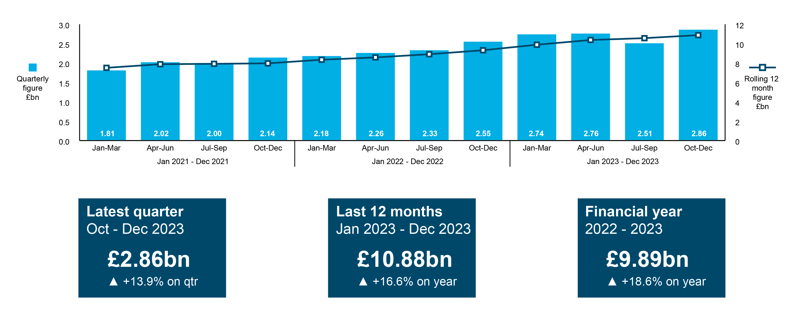
Northern Ireland Latest Export Results
Quarter 4 2023

Slide 3
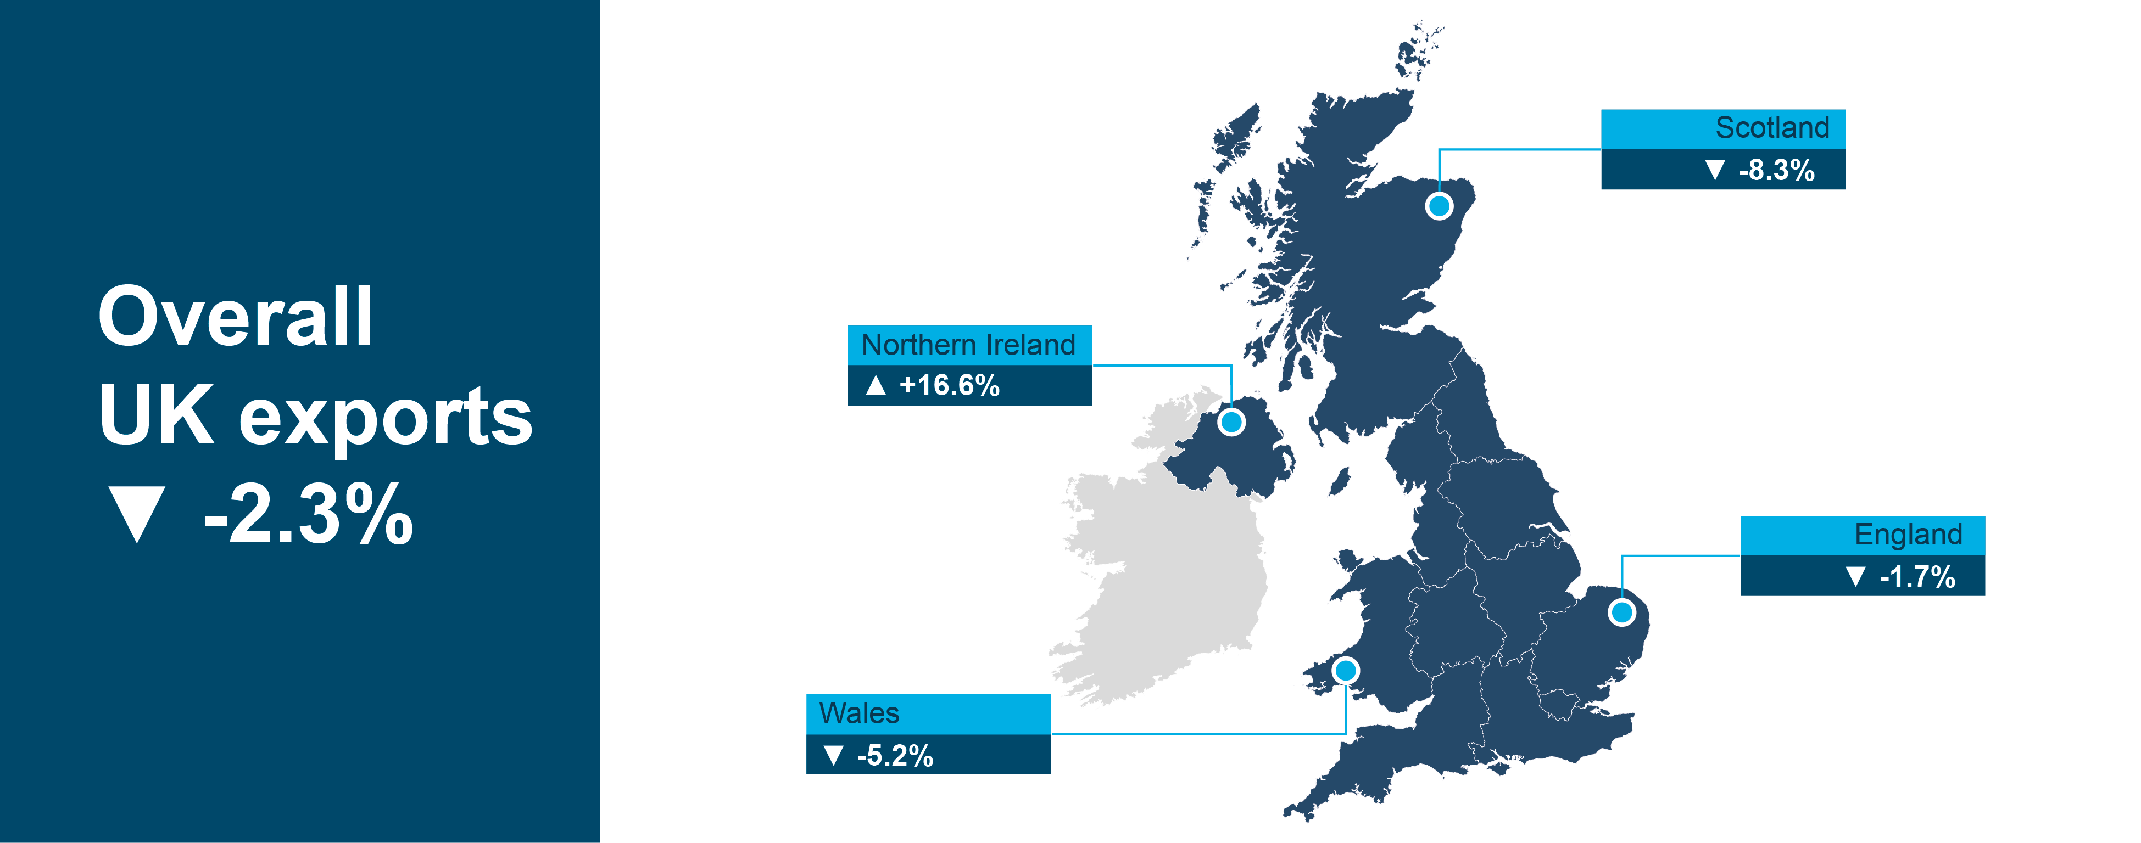
UK regional export results
Jan 2023 – Dec 2023

Slide 4
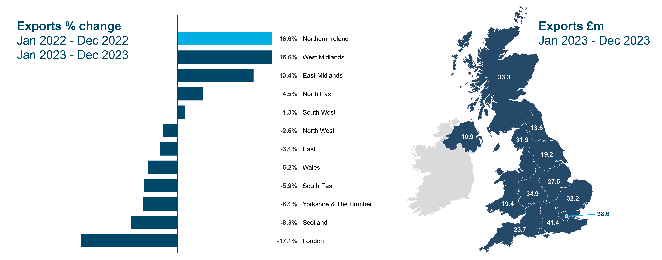
UK regional export results
Jan 2023 – Dec 2023

Slide 5
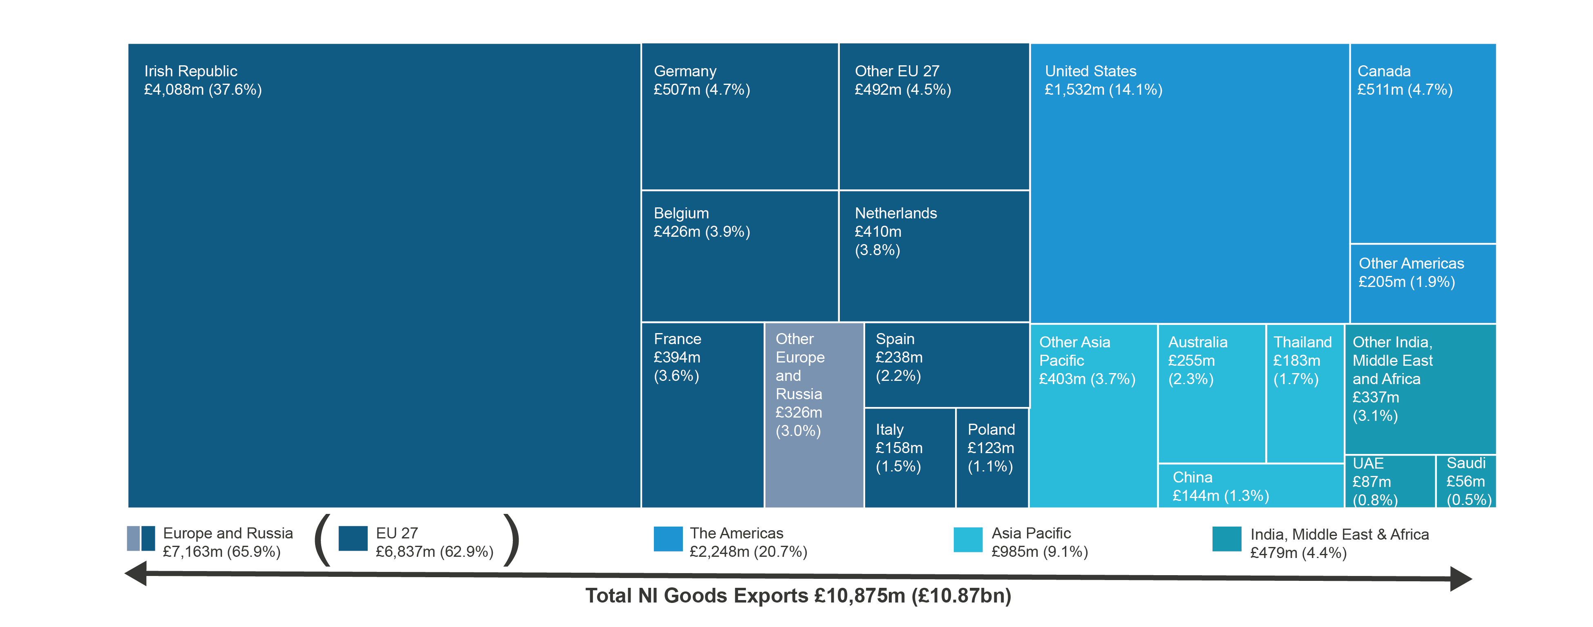
Where are we exporting to?
Jan 2023 – Dec 2023

Slide 6
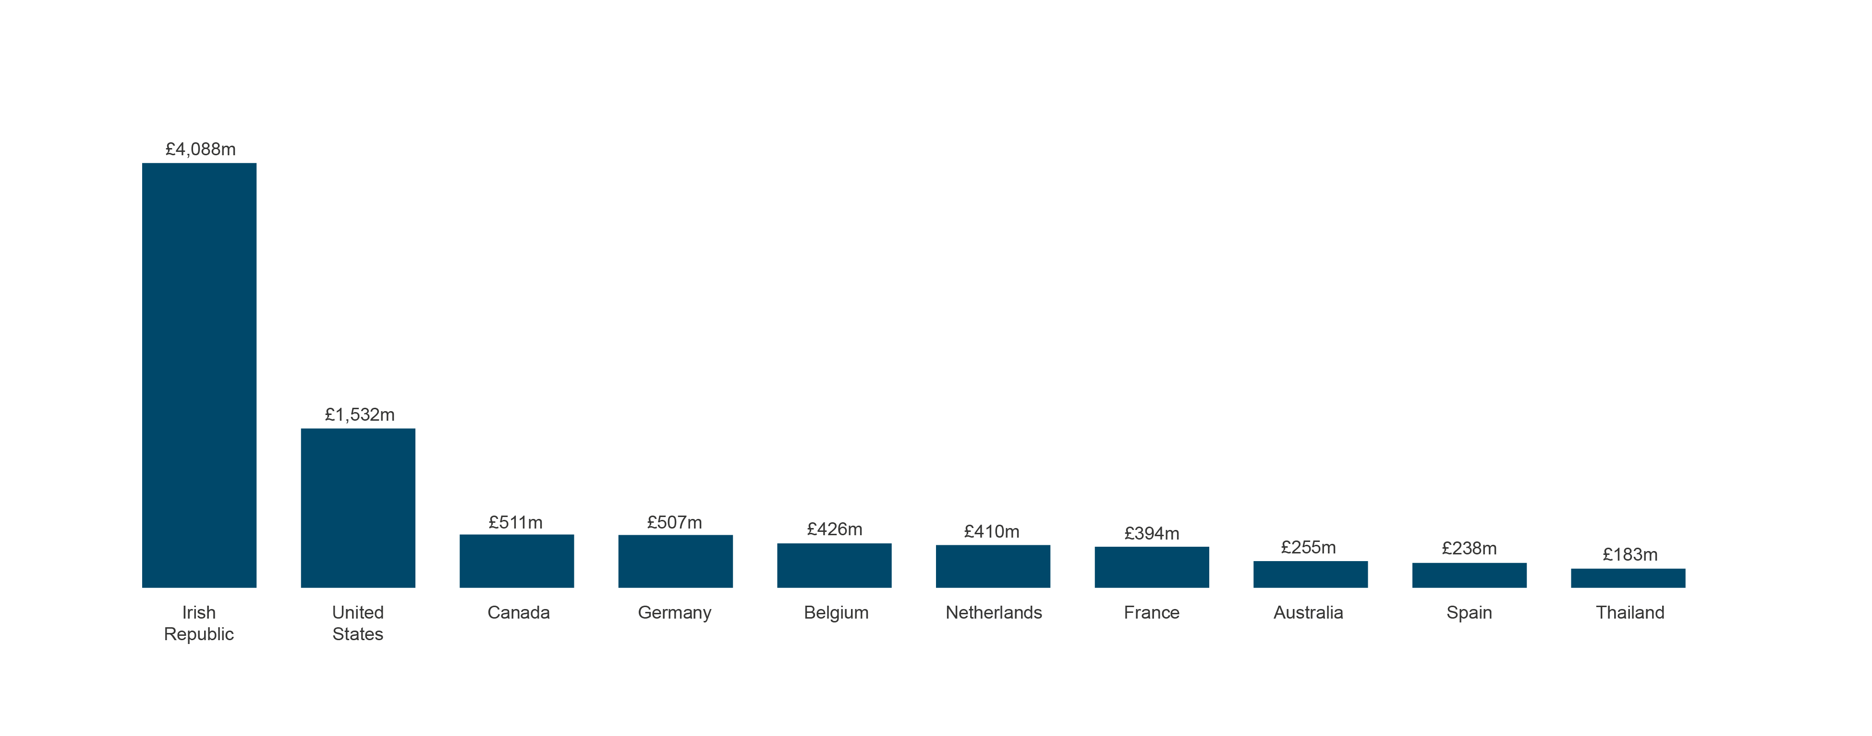
Top 10 countries for exports
Jan 2023 – Dec 2023

Slide 7
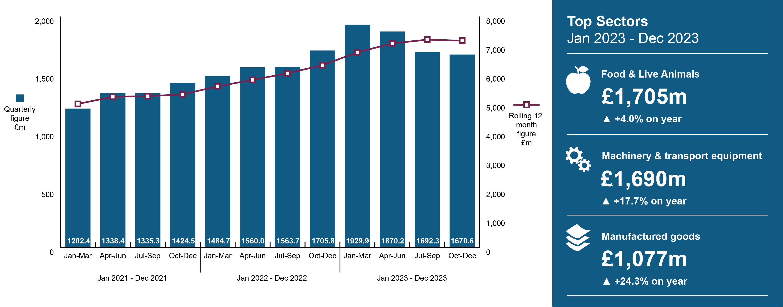
Europe and Russia

Slide 8
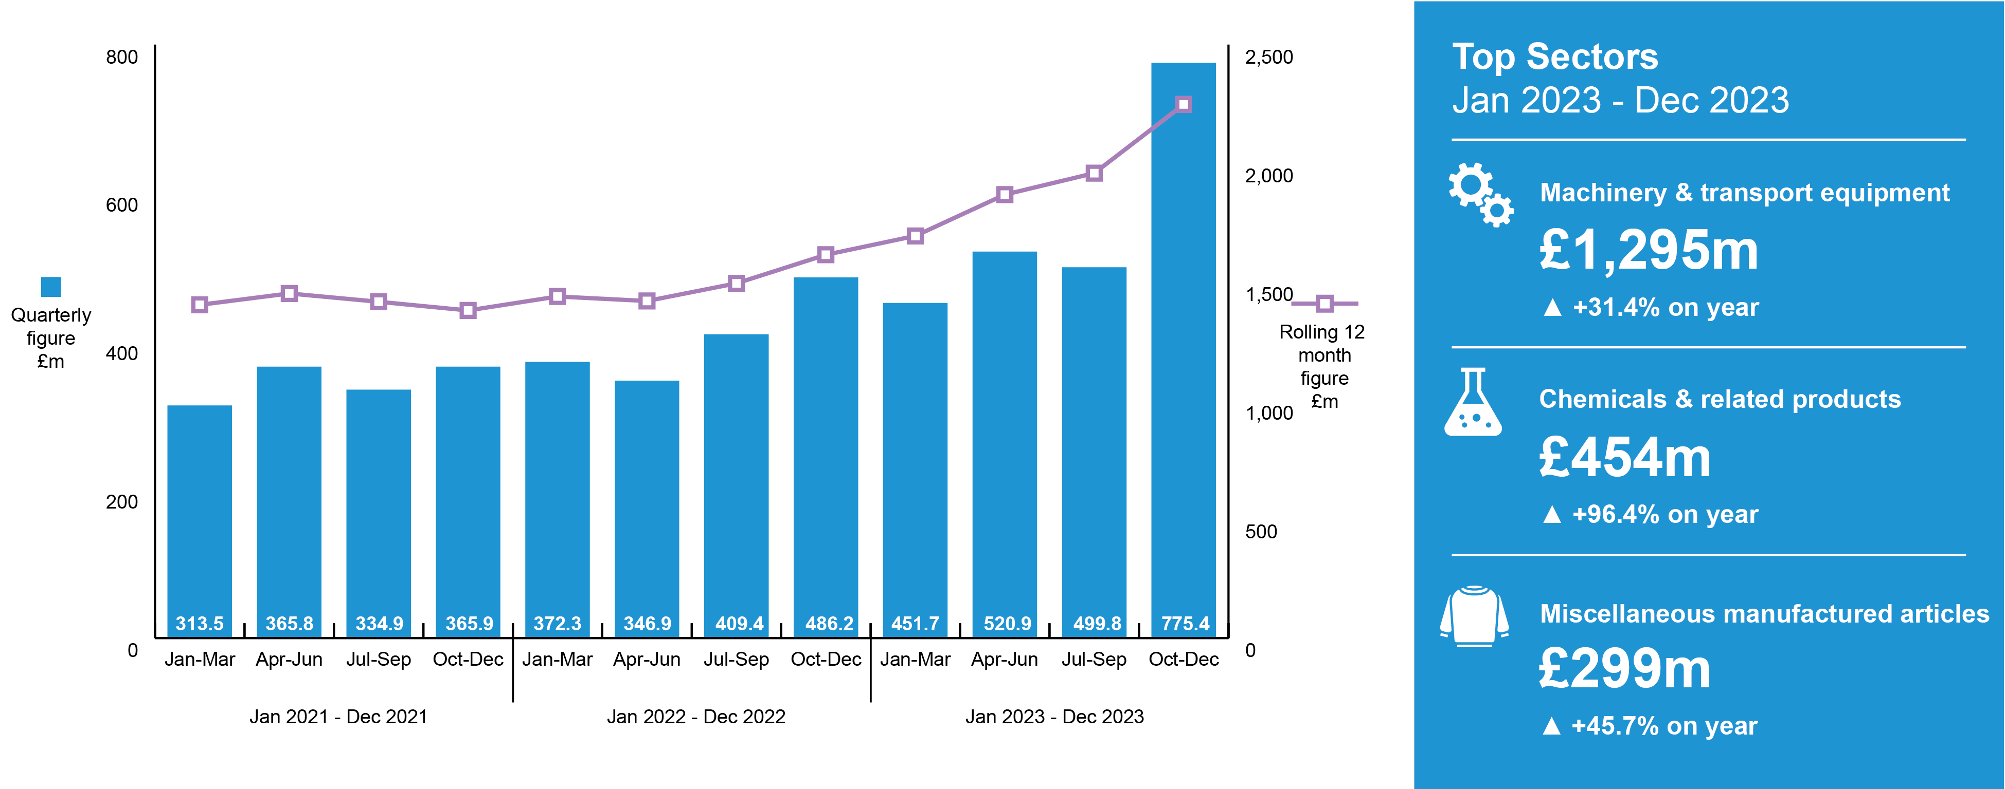
The Americas

Slide 9
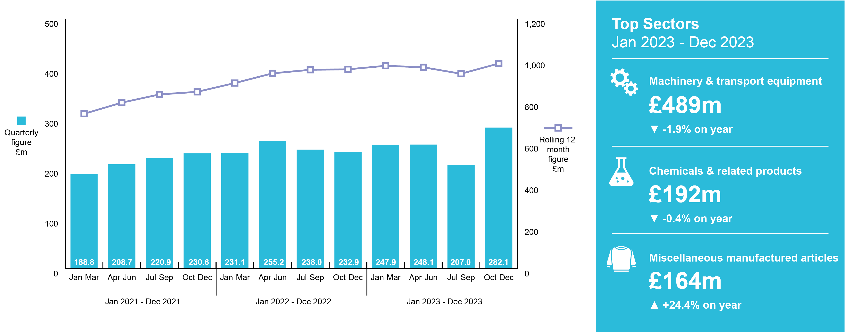
Asia Pacific

Slide 10
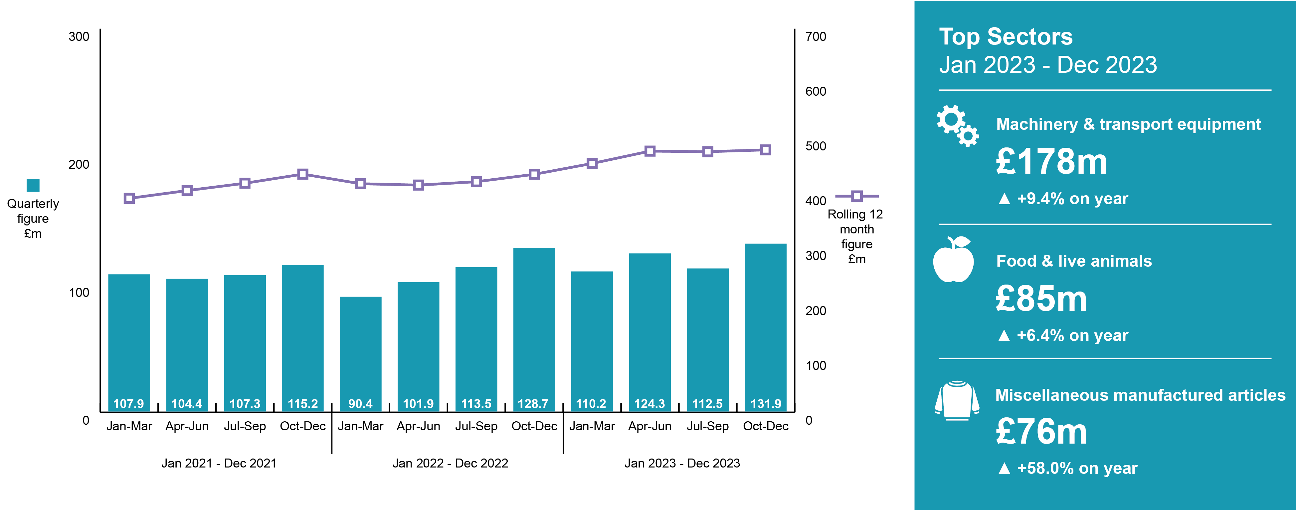
India, Middle East & Africa

Slide 11
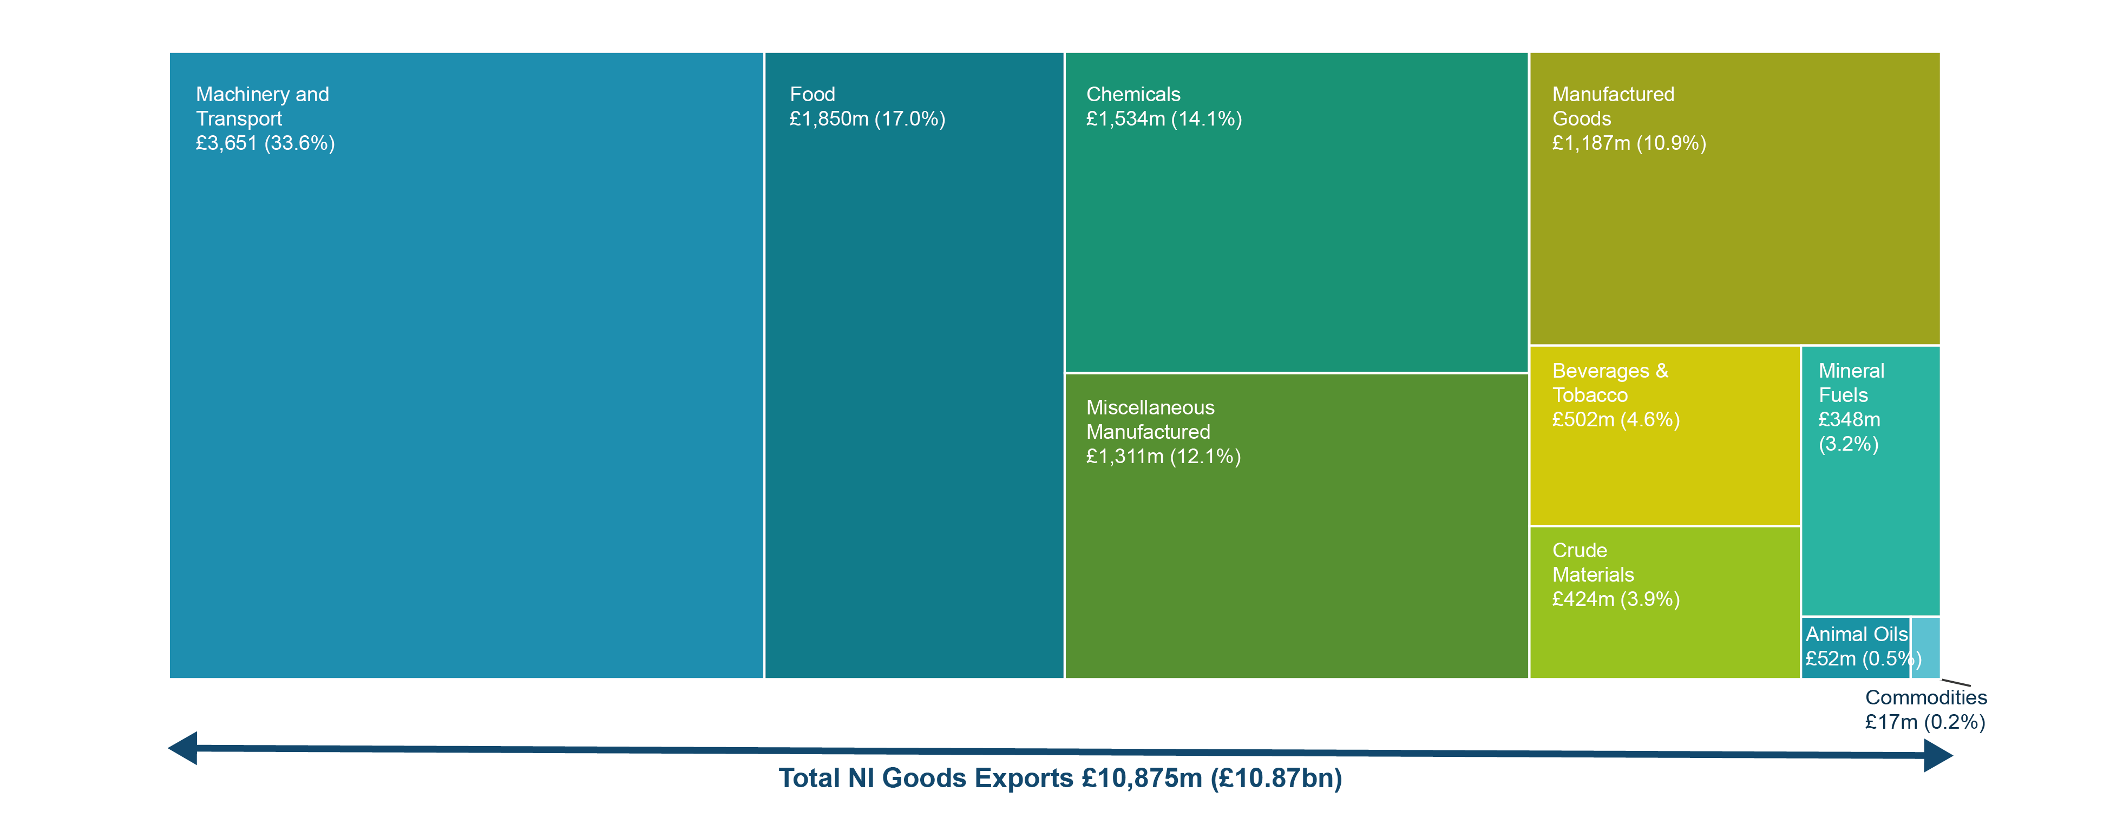
NI sector exports
Jan 2023 – Dec 2023

