Slide 1

Employee Connection Groups
Our Employee Connection Groups provide an energising and inclusive space where individuals from all backgrounds can come together, share experiences, and build meaningful relationships within the workplace. These groups empower employees to find community, celebrate diversity, and access valuable resources for personal and professional growth. By fostering open dialogue, cultural awareness, and mutual support, our Employee Connection Groups play a vital role in enhancing employee well-being, promoting a sense of belonging, and driving engagement across our organisation. Their activities and initiatives help break down barriers, ensuring everyone feels seen, heard, and valued as part of our vibrant workplace community

Slide 2
Young Employee Connection Group
Building Community, Confidence, and Change
The Young Employee Connection Group (YECG) is a vibrant hub where colleagues aged 35 and under come together to spark new friendships, share their journeys, and support one another as they launch rewarding careers. If you are eager to connect with peers, broaden your horizons, and make a real impact, we can support you through energising initiatives like Coffee Roulette, dynamic networking lunches, and hands-on workshops. YECG creates countless opportunities for young professionals to build confidence, expand their networks, and weave a sense of belonging across the organisation.
But YECG is more than just a social network—it’s a powerful voice for change. By championing awareness of the unique challenges younger employees face, and fostering collaboration to drive positive transformation, YECG ensures every rising professional feels heard, empowered, and ready to thrive. Join us and be part of the movement shaping the future!

Slide 3
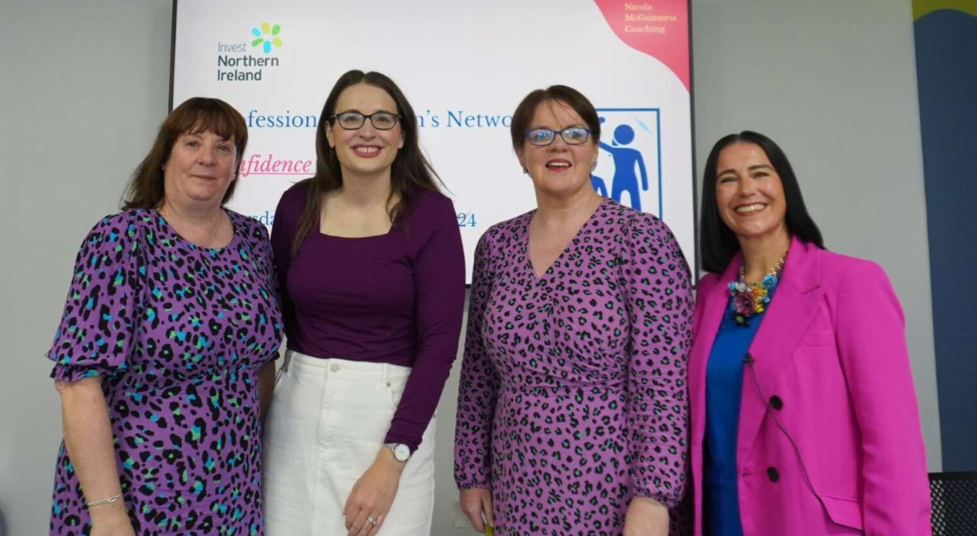
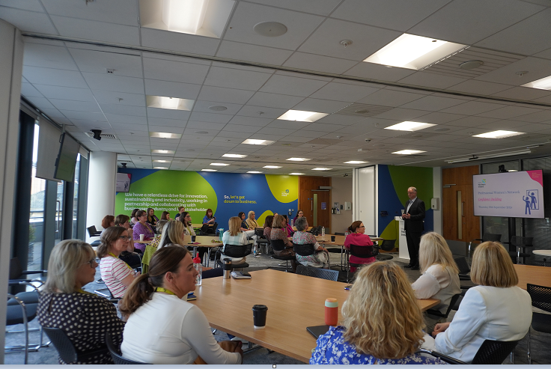
Professional Women’s Network
Empowering Women, Building Community
Driven by a passion for empowerment, the Professional Women’s Network inspires women to achieve their fullest potential through a foundation of respect, trust, and meaningful mentorship. The Network champions professional growth and cultivates a vibrant community where support and success go hand in hand. Throughout the year, members can take part in a dynamic array of events and activities—each designed to spark development, ignite new connections, and nurture lasting relationships.

Slide 4
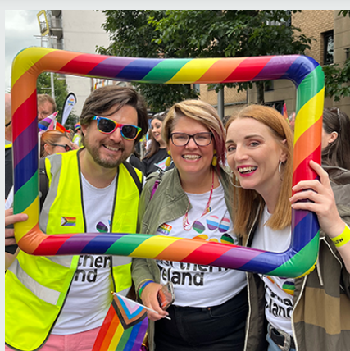
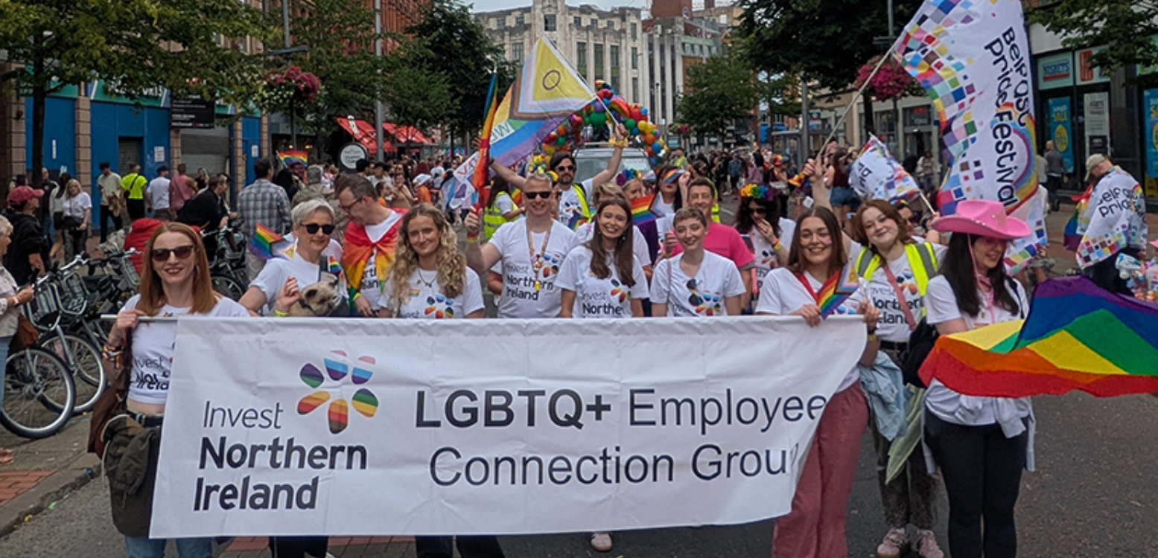
LGBTQ+ Employee Connection Group
Where Everyone Belongs and Thrives
At Invest NI, our LGBTQ+ Employee Connection Group is more than just a network — it’s a vibrant community dedicated to visibility, inclusion, and belonging. Here, every colleague is encouraged to bring their whole self to work, knowing they’ll be seen, valued, and truly connected, wherever they’re based or however they identify.
We shine a spotlight on LGBTQ+ stories and experiences, championing allyship and fostering understanding across our organisation. By sharing our voices and perspectives, we’re actively shaping a culture where everyone is empowered to flourish as their authentic selves.
Together, we’re making sure that Invest NI isn’t just a workplace, but a welcoming home for all — a place where diversity is celebrated, inclusion is lived, and everyone has the opportunity to blossom.

Slide 5
Men’s Health & Wellbeing Group
Building Connections, Breaking Barriers
Imagine a place where men can talk openly, find understanding, and receive support—long before challenges reach a breaking point. That’s the heart of the Men’s Health and Wellbeing Group. Our mission goes beyond conversation: we’re shattering stigmas, inspiring healthy routines, and creating genuine connections among all employees.
Through regular meetups, practical resources, and a strong network of peer support, the group empowers everyone to take charge of their mental and physical health. Together, we’re building a workplace where communication, community and connection come together to deliver better outcomes for our people.

